Slide 1
2110654 Artificial Intelligence (Master Course) (1/2024)
Time Scheduling
by genetic algorithm
Kwanchanok Hensawang 6770222321
Nattapong Mangking 6770236121
Krissada Sarawit 6770215021

Slide 2





Problem Statement
How to allocate the life schedule of master degree student using AI algorithm?

Slide 3
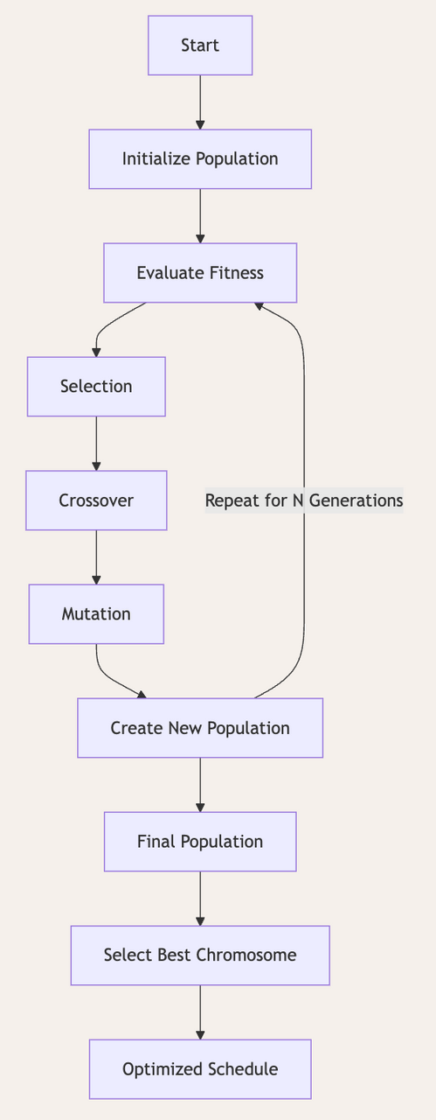






Genetic Algorithm Solution
1
2
3
4
Select Best of Individual
Breed new generation
Evaluate the fitness of children
Time-Table generated!
Parent to reproduce
Through crossover and mutation
Until terminal criteria reach
The weekly and daily schedule were generate

Slide 4
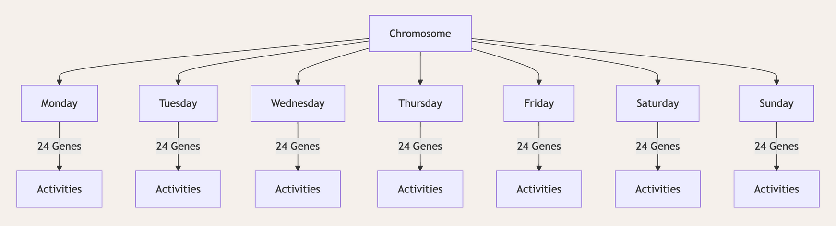
Steps in solving scheduling problems:
1
Chromosome Structure
Mandatory Activity - Work, Class, Sleep, Eat
Beneficial Activity - Rest, Exercise, Socializing, Leisure

Slide 5
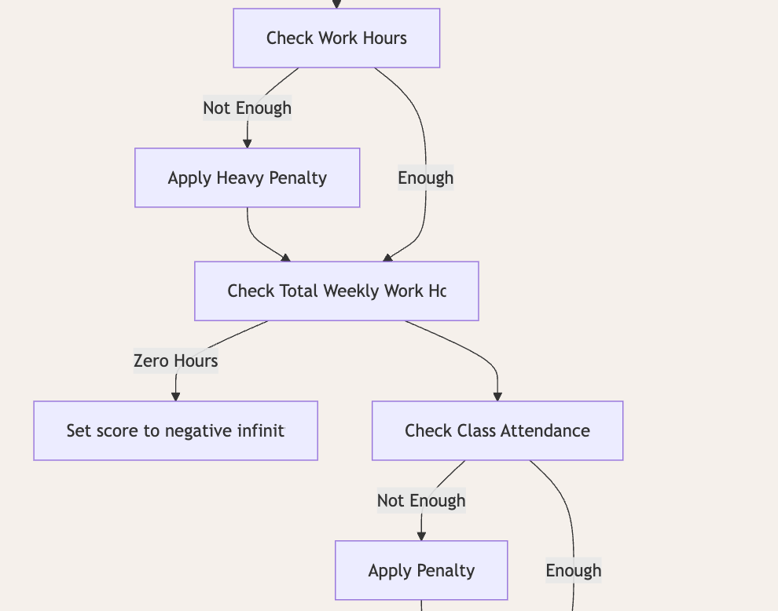
Steps in solving scheduling problems:
2
Fitness Function
Example of Penalty:
1. Not Working Enough Hours:
Penalty: -1000 * hours_missed
Dead individual if no work in a week: score = -infinity.
2. Class Attendance:
Penalty: -100 * hours_missed.
3. Missing Sunday commute: -50.
4. Not Sleeping Enough:
Penalty: -100 * hours_missed.
5. Skipping Meals:
Penalty: -50 * meals_missed.
6.Not Engaging in Beneficial Activities (e.g., Exercise):
Penalty: -20; reward for engagement: +10 * hours.
7.Skipping Personal Care:
Penalty: -30.
Penalty - 1000
Reward + 300

Slide 6
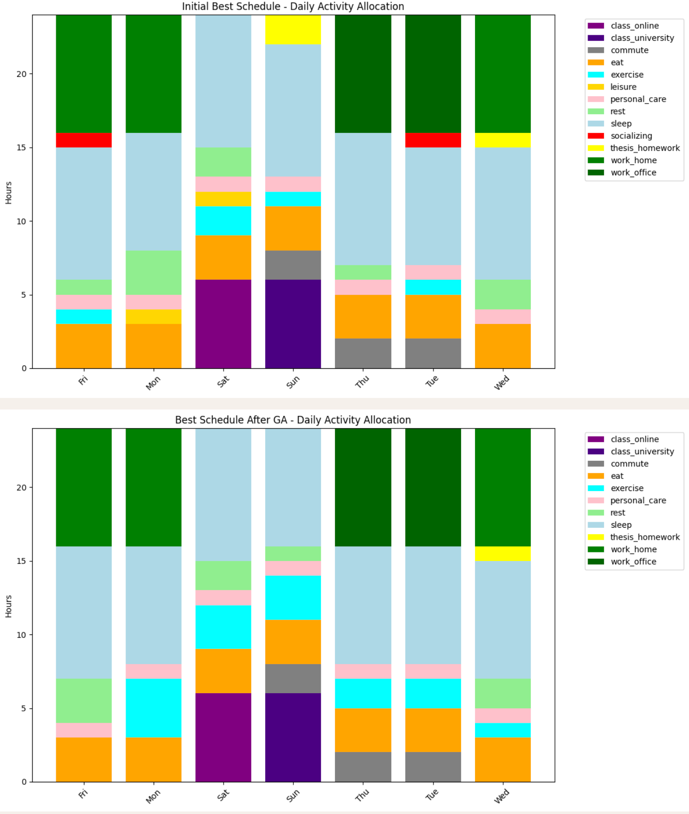
What the result telling us?
Weekly Result
Socializing Less and Leisure Less = Time to More Rest and More Exercise
1
4
1
4
3
3
2
2

Slide 7
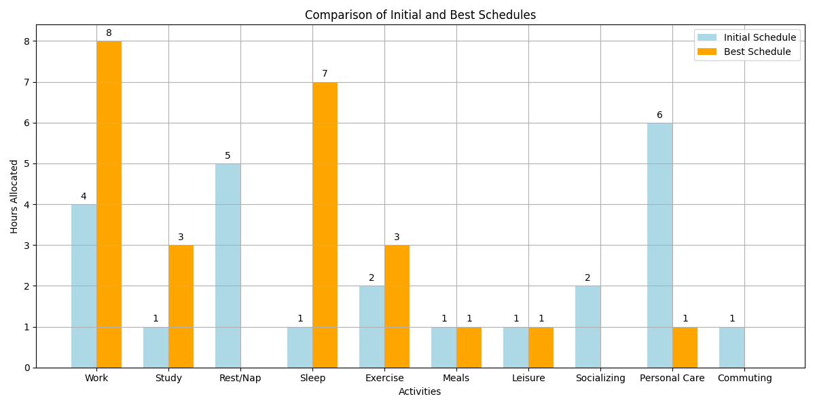
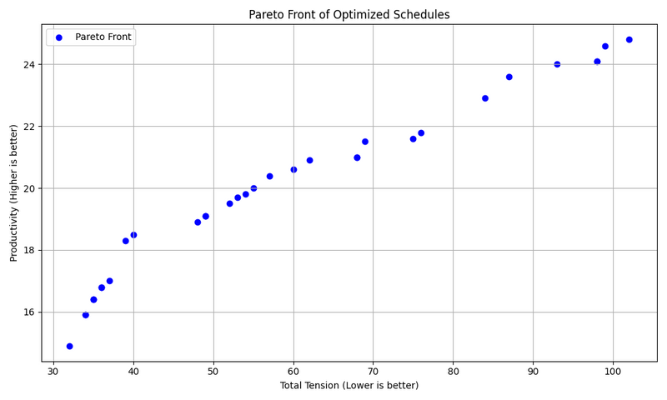
What the result telling us?
Daily Result
More Work and More Study and More Sleep = Time to Less Rest and Less Personal Care
More productivity

Slide 8
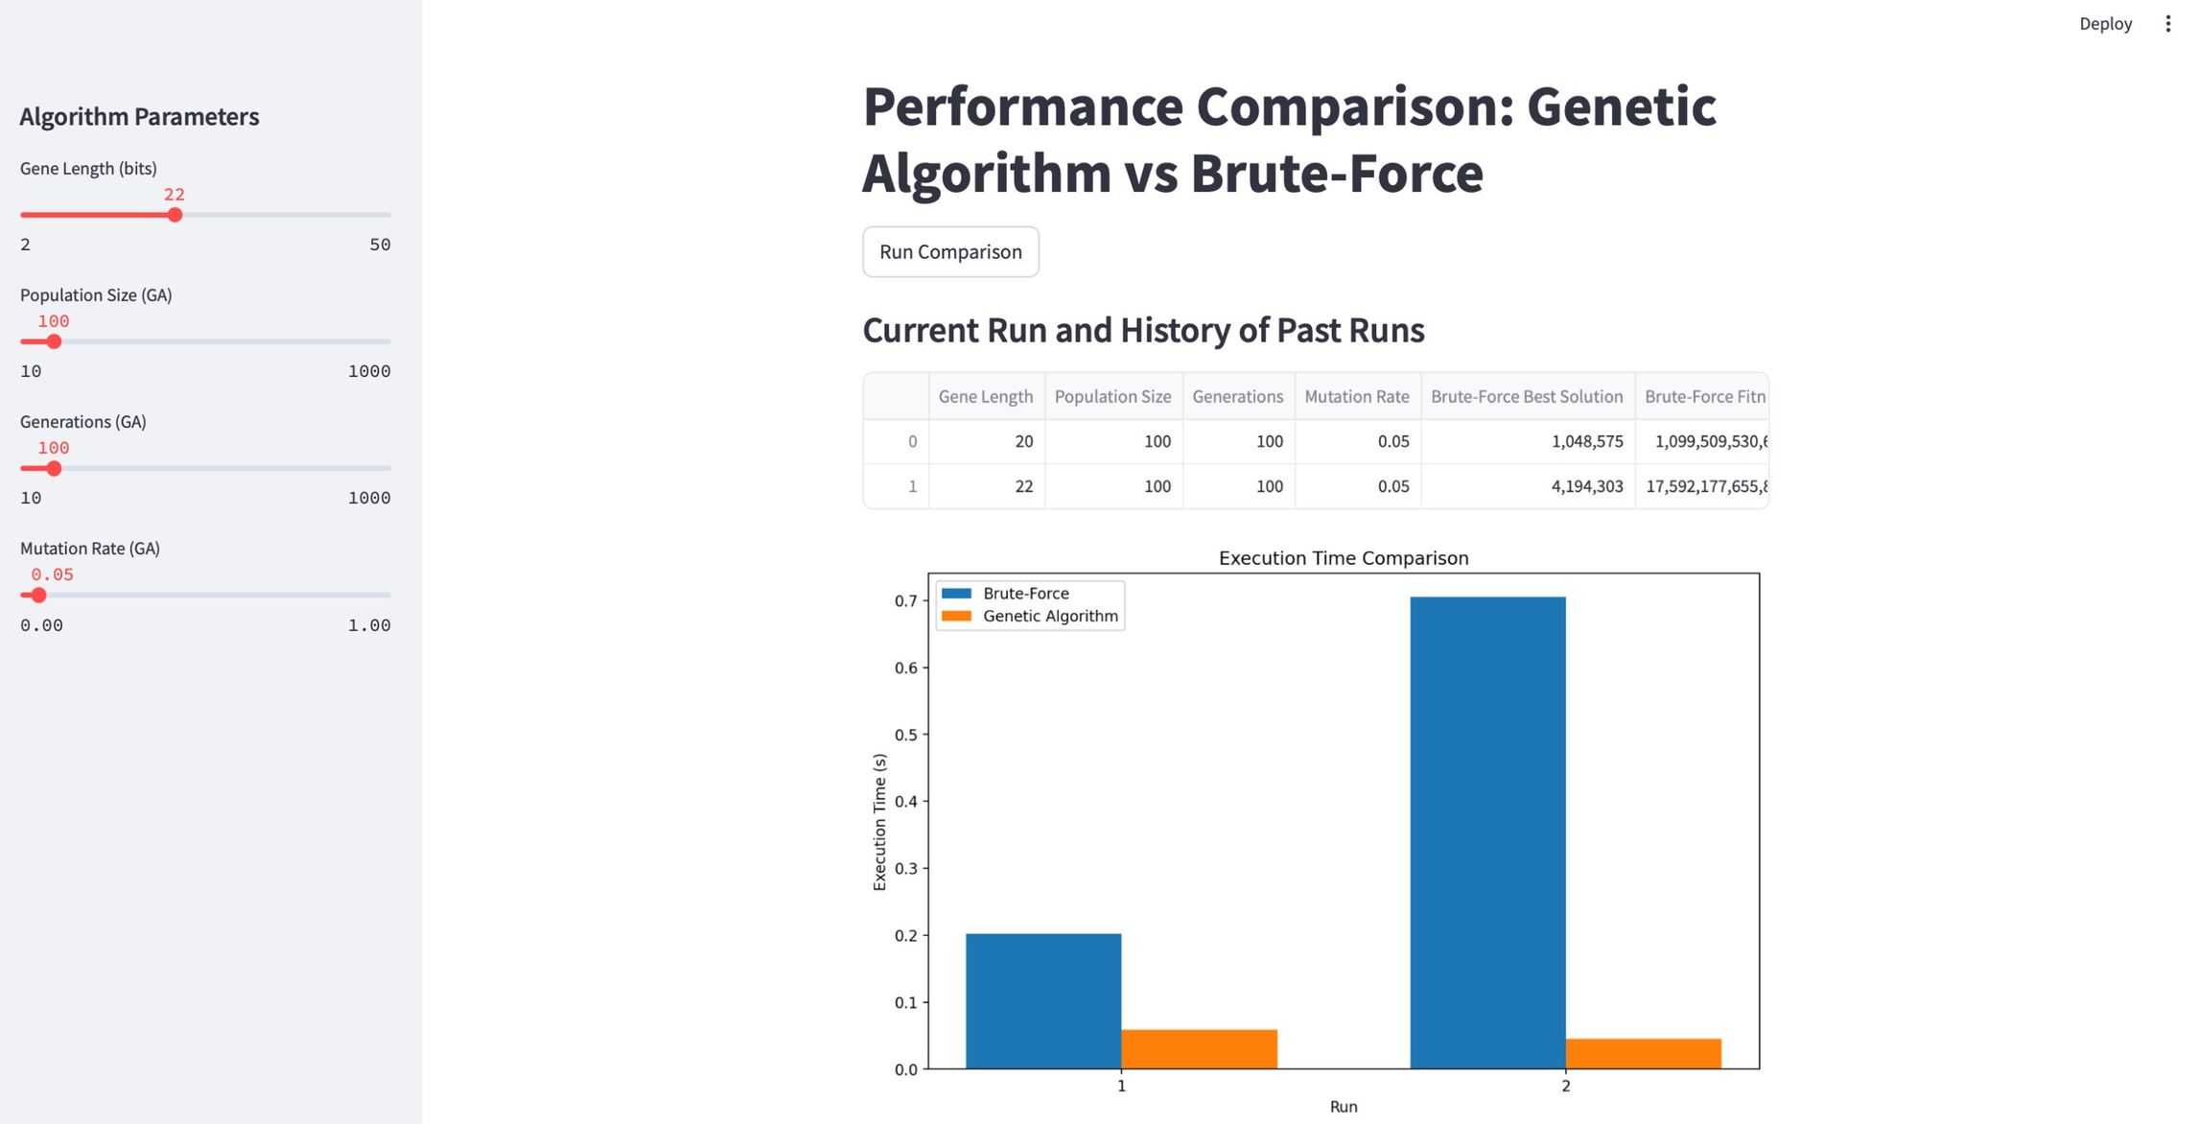
Brute Force vs GA
EXECUTION TIME COMPARISON: BRUTE FORCE VS GENETIC ALGORITHM
Example: 20-22 bits
Our project = 24*7 = 168 bits
Faster Execution time exponentially
1750%
400%

Slide 9
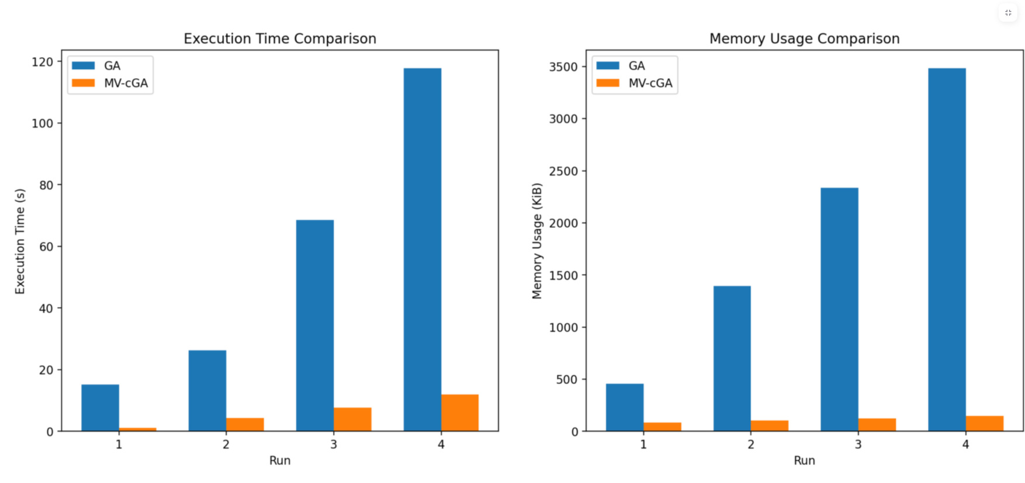
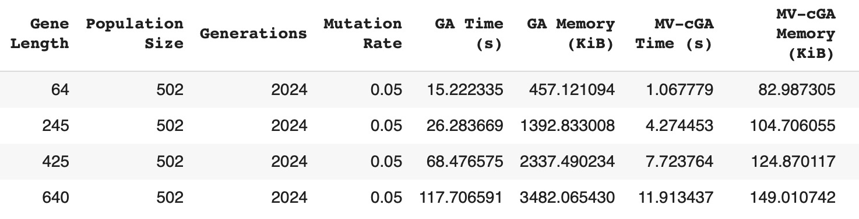
Time and Memory of GA vs cGA
EXECUTION TIME AND MEMORY USAGE COMPARISON: GENETIC ALGORITHM VS COMPACT GENETIC ALGORITHM
CGA HELP LESS SPACE USAGES

Slide 10



Future Study
Issue: The project example may lack realism.
GA is designed to maximize productivity based on pre-set rules (penalty and productivity).
It does not account for human exhaustion in real-life scenarios.

Slide 11






Thank you
FOR YOUR ATTENTION

